Slide 1
CSE477
VLSI Digital Circuits
Fall 2002
Lecture 24: RAM Cores
Mary Jane Irwin ( www.cse.psu.edu/~mji ) www.cse.psu.edu/~cg477
[Adapted from Rabaey’s Digital Integrated Circuits, ©2002, J. Rabaey et al.]

Slide 2
Review: Basic Building Blocks
Datapath
  Execution units
    Adder, multiplier, divider, shifter, etc.
  Register file and pipeline registers
  Multiplexers, decoders
Control
  Finite state machines (PLA, ROM, random logic)
Interconnect
  Switches, arbiters, buses
Memory
  Caches (SRAMs), TLBs, DRAMs, buffers

Slide 3
Review: Read-Write Memories (RAMs)
Static – SRAM
  data is stored as long as supply is applied
  large cells (6 fets/cell) – so fewer bits/chip
  fast – so used where speed is important (e.g., caches)
  differential outputs (output BL and !BL)
  use sense amps for performance
  compatible with CMOS technology
Dynamic – DRAM
  periodic refresh required
  small cells (1 to 3 fets/cell) – so more bits/chip
  slower – so used for main memories
  single ended output (output BL only)
  need sense amps for correct operation
  not typically compatible with CMOS technology

Slide 4
Review: 4x4 SRAM Memory
read precharge
2 bit words
bit line precharge
enable
WL[0]
!BL
BL
A₁
WL[1]
Row Decoder
A₂
WL[2]
WL[3]
A₀
Column Decoder
clocking and control
sense amplifiers
BL[i]
BL[I+1]
write circuitry
Notes:
To decrease the bit line delay for reads – use low swing bit lines, i.e., bit lines don’t swing rail-to-rail, but precharge to Vdd (as 1) and discharge to Vdd – 10%Vdd (as 0). (So for 2.5V Vdd, 0 is 2.25V.) Requires sense amplifiers to restore to full swing.
Write circuitry – receives full swing from sense amps – or writes full swing to the bit lines

Slide 5
6-transistor SRAM Cell
WL
M2
M4
Q
M6
M5
!Q
M1
M3
!BL
BL
Notes:
Note that it is identical to the register cell from static sequential circuit - cross-coupled inverters
Consumes power only when switching - no standby power (other than leakage) is consumed
The major job of the pullups is to replenish loss due to leakage
Sizing of the transistors is critical

Slide 6
SRAM Cell Analysis (Read)
WL=1
M4
M6
!Q=0
M5
Q=1
M1
C_{bit}
C_{bit}
!BL=1
BL=1
Read-disturb (read-upset): must carefully limit the allowed voltage rise on !Q to a value that prevents the read-upset condition from occurring while simultaneously maintaining acceptable circuit speed and area constraints
Notes:
First precharge both bit lines – BL and !BL – to 1 - Note that bit line capacitance values for Cbit can be in the pF range for large memories (bit line capacitance is from wiring and from diffusion caps of M5’s of all the cells connected to the bit line and the load presented by the sense amp)
Then discharge !BL through M5 and M1 (since the cell is holding 1) – key is that you must ensure that the !Q point doesn’t rise too high before Cbit is discharged or the memory cell will change state- read-disturb. So, the resistance of M5 must be larger than M1 (M5 with bigger L, so that M1 is faster than M5)
But this is overly conservative since BL being 1 will help to keep the cell from toggling. Or can precharge the bit lines to Vdd/2 so !Q could never reach the switching point. This has performance benefits as well.

Slide 7
SRAM Cell Analysis (Read)
WL=1
M4
M6
!Q=0
M5
Q=1
M1
C_{bit}
C_{bit}
!BL=1
BL=1
Cell Ratio (CR) = (W_{M1}/L_{M1})/(W_{M5}/L_{M5})
V_{!Q} = [(V_{dd} - V_{Tn})(1 + CR ±√(CR(1 + CR))]/(1 + CR)
Notes:
M5 in saturation, M1 in linear mode

Slide 8
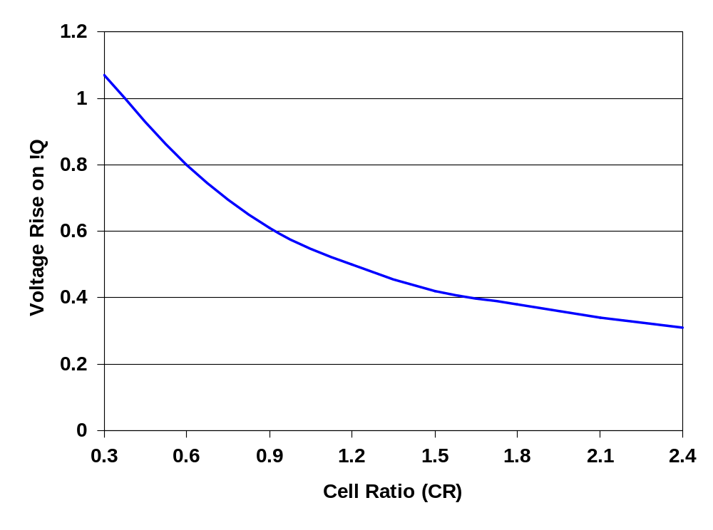
Read Voltages Ratios
V_{dd} = 2.5V
V_{Tn} = 0.5V
Notes:
To avoid read-disturb, the voltage on node !Q should remain below the trip point of the inverter pair for all process, noise, and operating conditions. CRs of no less than 1.2 (most microprocessor fabs use a minimum cell ratio of 1.25 to 2)
Simulations should be done at high Vdd and low VTn (and considering process variations and misalignments)

Slide 9
SRAM Cell Analysis (Write)
WL=1
M4
!Q=0
M6
M5
Q=1
M1
!BL=1
BL=0
Pullup Ratio (PR) = (W_{M4}/L_{M4})/(W_{M6}/L_{M6})
V_{Q} = (V_{dd} - V_{Tn}) ±√((V_{dd} – V_{Tn})² – (μ_{p}/μ_{n})(PR)((V_{dd} – V_{Tn} - V_{Tp})²)
Notes:
State shown is that before write takes effect (1 is stored, trying to write a 0)
In order to write the cell, the pass gate M6 must be more conductive than the M4 to allow node Q to be pulled to a value low enough for the inverter pair (M2/M1) to begin amplifying the new data.
The maximum ratio of the pullup size to that of the pass gate required to guarantee that the cell is writable – M6 in linear, M4 in saturation

Slide 10
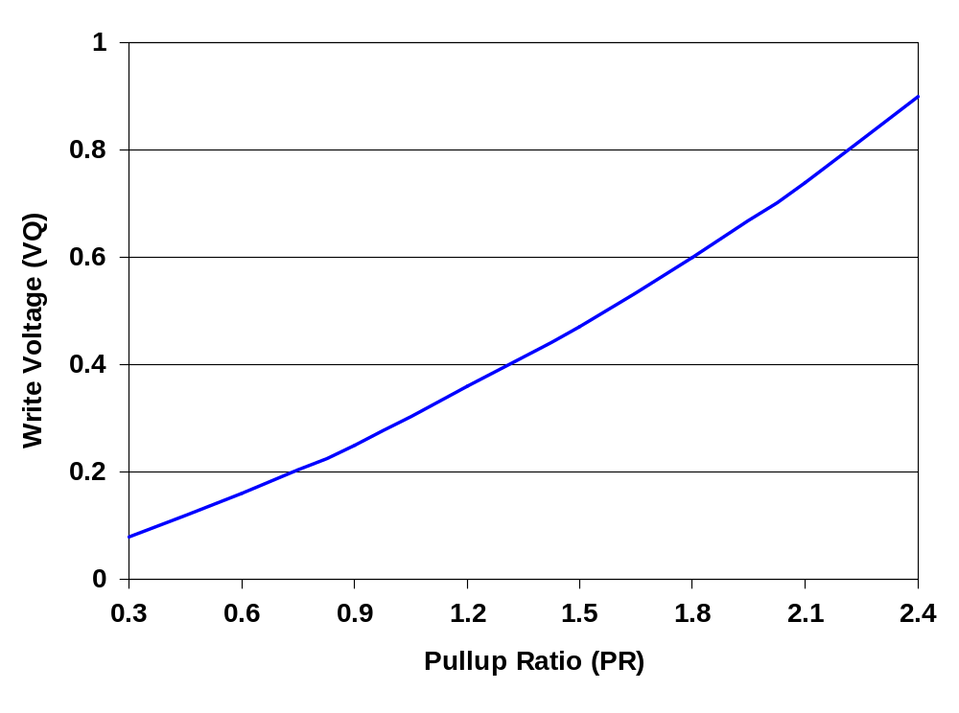
Write Voltages Ratios
V_{dd} = 2.5V
|V_{Tp}| = 0.5V
μ_{p}/μ_{n} = 0.5
Notes:
In order to write the cell, node Q must be pulled to a value low enough to trip the inverter combination – so pulling Q below VTn (0.5V) is required.
The limiting case for the write operation occurs at high Vdd when the pfet is strong (mup high, VTp low) and the nfet is weak (mun low, VTn high)
Typicaly, the widths of the pullup devices are sized at or near process minimum. Longer than minimum channel lengths may also be emplyed to further reduce the pullup ratio. This is necessary since the read sizing of the SRAM cell dictates that the pass gate sizing should be minimized to prevent read disturbs.

Slide 11
Cell Sizing
Keeping cell size minimized is critical for large caches
Minimum sized pull down fets (M1 and M3)
  Requires minimum width and longer than minimum channel length pass transistors (M5 and M6) to ensure proper CR
  But sizing of the pass transistors increases capacitive load on the word lines and limits the current discharged on the bit lines both of which can adversely affect the speed of the read cycle
Minimum width and length pass transistors
  Boost the width of the pull downs (M1 and M3)
  Reduces the loading on the word lines and increases the storage capacitance in the cell – both are good! – but cell size may be slightly larger

Slide 12

6T-SRAM Layout
V_{DD}
M2
M4
Q
Q
M1
M3
GND
M5
M6
WL
BL
BL
Notes:
Area is dominated by wiring and contacts – 11.5 contacts
SPEED – tp = CLVswing/Iav
Read – critical speed op since have large bit line capacitance to discharge through small transistors
Write – speed determined by the propagation delay of the cross-coupled inverters
tpLH > tpHL due to precharge
Other considerations – size of cell (1092 lambda**2 = 582 micron **2 by 0.7 micron design rules)
and power – standby/cell of 10**-15A

Slide 13
Multiple Read/Write Port Cell
WL2
WL1
M2
M4
M5
!Q
Q
M6
M7
M8
M1
M3
!BL2
!BL1
BL1
BL2
Notes:
Allows multiple simultaneous reads of the same cell, so the cell design must be stable for a case of multiple reads.
For the case of reads, with more than one pass gate open, the voltage rise in the cell will be larger and thus the size of the pulldown will have to be increased to maintain an acceptably low level (by a factor equal to the number of simultaneous open read ports).

Slide 14
4x4 DRAM Memory
read precharge
2 bit words
bit line precharge
enable
WL[0]
BL
A₁
WL[1]
Row Decoder
A₂
WL[2]
WL[3]
sense amplifiers
clocking, control, and refresh
BL[0]
BL[1]
BL[2]
BL[3]
write circuitry
A₀
Column Decoder
Notes:
To decrease the bit line delay for reads – use low swing bit lines, i.e., bit lines don’t swing rail-to-rail, but precharge to Vdd (as 1) and discharge to Vdd – 10%Vdd (as 0). (So for 2.5V Vdd, 0 is 2.25V.) Requires sense amplifiers to restore to full swing.
Write circuitry – receives full swing from sense amps – or writes full swing to the bit lines

Slide 15
3-Transistor DRAM Cell
WWL
WWL
write
RWL
V_{dd}
M3
BL1
M1
X
M2
X
V_{dd}-V_{t}
C_{s}
RWL
read
BL2
V_{dd}-V_{t}
ΔV
BL1
BL2
No constraints on device sizes (ratioless)
Reads are non-destructive
Value stored at node X when writing a “1” is V_{WWL} - V_{tn}
Notes:
Core of first popular MOS memories (e.g., first 1Kbit memory from Intel). Cs is data storage (internal capacitance of wiring, M2 gate, and M1 diffusion capacitances)
Note threshold drop at point X which decreases the drive (gate voltage) of M2 and slows down read time – some designs “bootstrap” the word line voltage (raise the VWWL to a value higher than Vdd to get around threshold drop).
Write – uses WWL and BL1.
Read – uses RWL and BL2. Assume BL2 precharged to Vdd (or Vdd-Vt). If cell is holding 1, then BL2 goes low – so reads are inverting.
Refresh – read stored data, put its inverse on BL1 and assert WWL (need to do this every 1 to 4 msec)

Slide 16

3T-DRAM Layout
BL2
BL1
GND
RWL
M3
M2
WWL
M1
Notes:
Note many fewer contacts (only 7) and wires than in 6-T SRAM cell
576 lambda**2 as compared to 1092 lambda**2 for SRAM cell

Slide 17
1-Transistor DRAM Cell
WL
write
“1”
read
“1”
WL
M1
X
X
V_{dd}-V_{t}
C_{s}
C_{BL}
BL
V_{dd}
BL
V_{dd}/2
sensing
Write: C_{s} is charged (or discharged) by asserting WL and BL
Read: Charge redistribution occurs between C_{BL} and C_{s}
Read is destructive, so must refresh after read
Notes:
Most pervasive DRAM cell in commercial designs.
Write – set BL and activate WL. Once again could bootstrap WL so that voltage drop at X doesn’t occur (to bring it up to Vdd) – common practice
Read - BL precharged to Vpre – typically Vdd/2 – then assert WL and sense state of BL that takes effect due to charge sharing between CBL and Cs. Note that Read is destructive (steal charge from Cs) so must follow with a refresh cycle. Note that Cs << CBL (1 to 2 orders of magnitude) so read voltage swings are typically very small (around 250mV for 0.8 micron technology?). Charge transfer rations are between 1% and 10%
delta V = VBL – Vpre = (Vbit – Vpre) (Cs/(Cs + CBL))
REQUIRES a sense amp for each bit line for correct operation (wereas before was used to improve performance (via reduced bit line swings on reads))

Slide 18
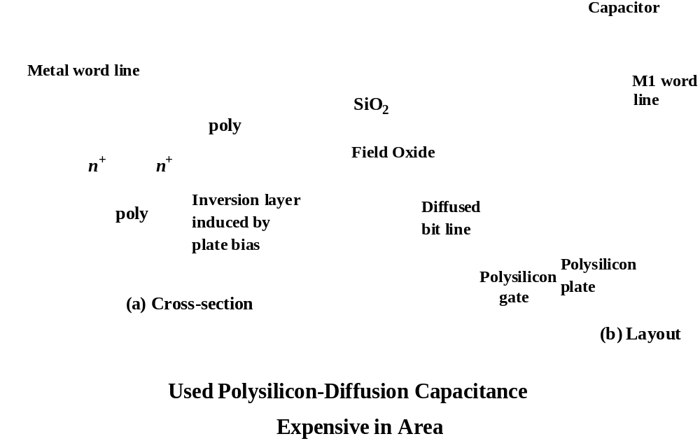
1-T DRAM Cell
Notes:
How to build the capacitor. Need to “build” and explicit capacitor that is both small and good – the key design challenge in 1T DRAM cells.
Note that the technology is not compatible with CMOS logic technology.

Slide 19
DRAM Cell Observations
DRAM memory cells are single ended (complicates the design of the sense amp)
1T cell requires a sense amp for each bit line due to charge redistribution read
1T cell read is destructive; refresh must follow to restore data
1T cell requires an extra capacitor that must be explicitly included in the design
A threshold voltage is lost when writing a 1 (can be circumvented by bootstrapping the word lines to a higher value than V_{dd})

Slide 20
Next Lecture and Reminders
Next lecture
  Peripheral memory circuits
    Reading assignment – Rabaey, et al, 12.3
Reminders
  Project final reports due December 5th
  Final grading negotiations/correction (except for the final exam) must be concluded by December 10th
  Final exam scheduled
    Monday, December 16th from 10:10 to noon in 118 and 121 Thomas

